Slide 1
Wanderers of the Rift
WEEKLY UPDATE
2025/03/29

Slide 2

Agenda
Kudos & Recognition
Values Next Steps
Polls
MVP Updates
Assembly
Build
Demos
Q&A

Slide 3

Kudos &
Recognition

Slide 4

Values Next Steps
Value | Accepted | Accepted with changes
Open Source | 100%
Anyone can contribute | 80% | 20%
Polling Decisions and priority | 85% | 15%
Distributed Leadership | 96% | 4%
Play Your Way | 93% | 7%
Custom Configs | 96% | 4%
Open Communication | 93% | 7%
All values listed here will be published to CoC
Monetary involvement discussion will conclude in 3 days (EOD Tuesday)
Polling options will then be agreed upon and poll started

Slide 5
Polls
Closed - Pitch to Feature (97% Yes as is)
Open
POI Depth
Art Specific - Entity Animation - Gecko vs Vanilla
Upcoming
Monetary specifications for CoC
Theme(s)?
Fabric/Cloth/Weaving
No singular unifying theme
Texture pack variety

Slide 6

MVP Updates

Slide 7

MVP Assembly
Rift Key forging POC finalized by DividesByZero
Structure generation performance improvements and finalizations by Patrigan
Skybox blocks by Wh4I3
Abilities - Massive backend improvements, ability cooldown display, and Dash ability by DividesByZero and Patrigan with the help of Robotmonkey and T2ThatGuy
Rune Anvil - Backend updates to increase variety and capabilities by Patrigan
Dimension Gen improvements by Mel and Rizek
3d Map - connection solver implementation by Anorak (demo video)
Spawnpiece command (devtools) by DividesByZero

Slide 8
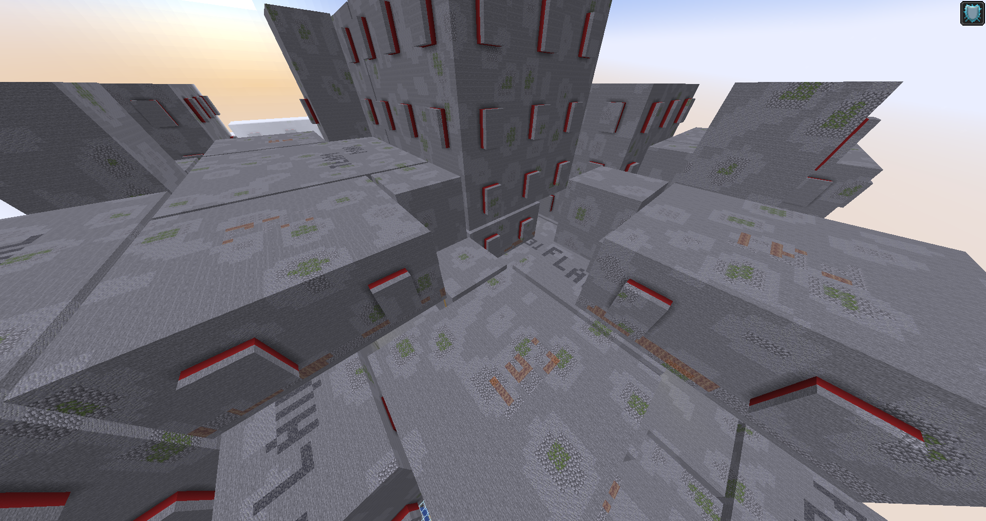

Slide 9
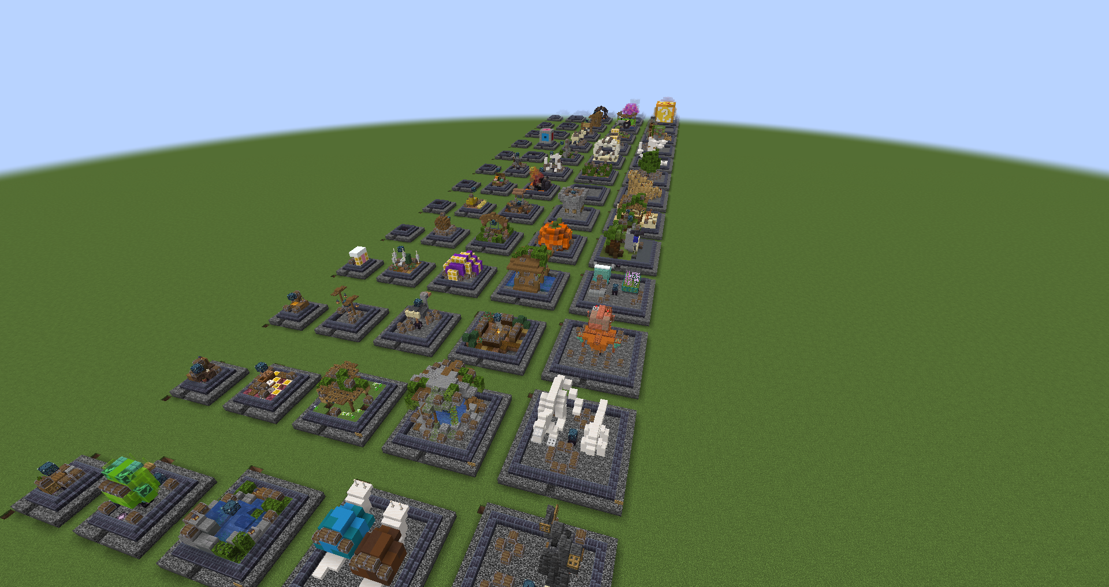

Slide 10
DEMOS!

Slide 11
Q&A

